Slide 1
Node.js
Notes:
.

Slide 2
Node.js File System Module
The Node.js file system module allows you to work with the file system on your computer.
To include the File System module, use the require() method:
var fs = require('fs');
Common use for the File System module:
Read files
Create files
Update files
Delete files
Rename files

Slide 3
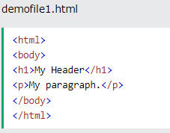
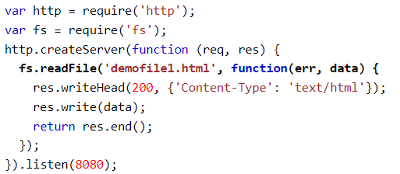

Read Files
The fs.readFile() method is used to read files on your computer.

Slide 4
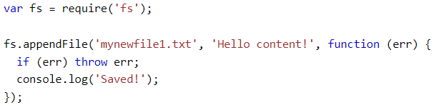
Create Files
The File System module has methods for creating new files:
fs.appendFile()
fs.open()
fs.writeFile()

Slide 5
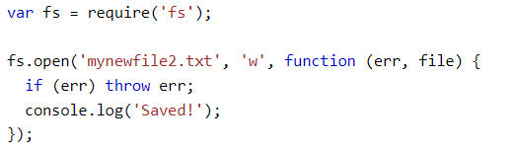
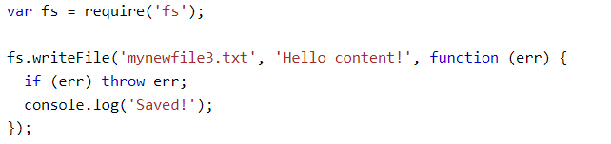
Create Files

Slide 6
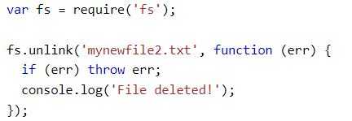
Delete Files
To delete a file with the File System module, use the fs.unlink() method.
The fs.unlink() method deletes the specified file:

Slide 7
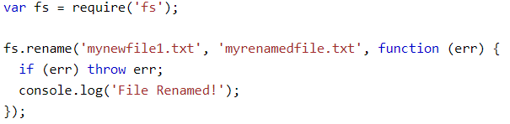
Rename Files
To rename a file with the File System module, use the fs.rename() method.
The fs.rename() method renames the specified file:
Rename "mynewfile1.txt" to "myrenamedfile.txt":

Slide 8
Node.js Upload Files
The Formidable Module
There is a very good module for working with file uploads, called "Formidable".
The Formidable module can be downloaded and installed using NPM:
C:\Users\Your Name>npm install formidable
After you have downloaded the Formidable module, you can include the module in any application:
var formidable = require('formidable');

Slide 9
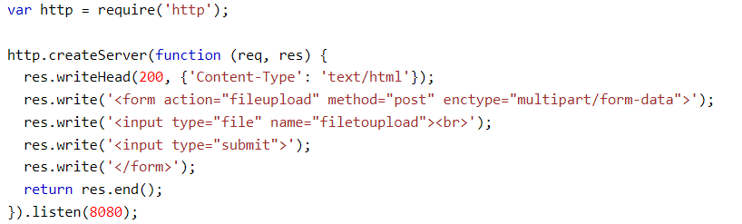
Node.js Upload Files
Step 1: Create an Upload Form

Slide 10
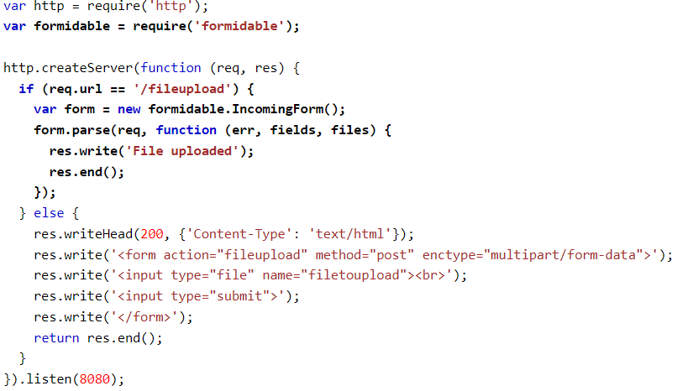
Node.js Upload Files
Step 2: Parse the Uploaded File
Include the Formidable module to be able to parse the uploaded file once it reaches the server.
When the file is uploaded and parsed, it gets placed on a temporary folder on your computer.

Slide 11
Node.js Upload Files
Step 3: Save the File
When a file is successfully uploaded to the server, it is placed on a temporary folder.
The path to this directory can be found in the "files" object, passed as the third argument in the parse() method's callback function.
To move the file to the folder of your choice, use the File System module, and rename the file:

Slide 12
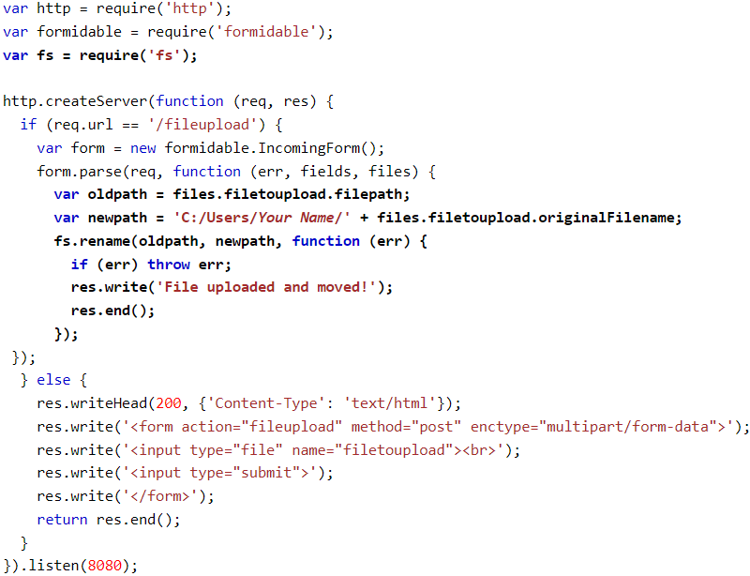
Node.js Upload Files
Step 3: Save the File

Slide 13
Task
Create a dynamic Image gallery using node.js in which images can be uploaded from clients and it should have the facility to delete the desired image from the gallery.

Slide 14
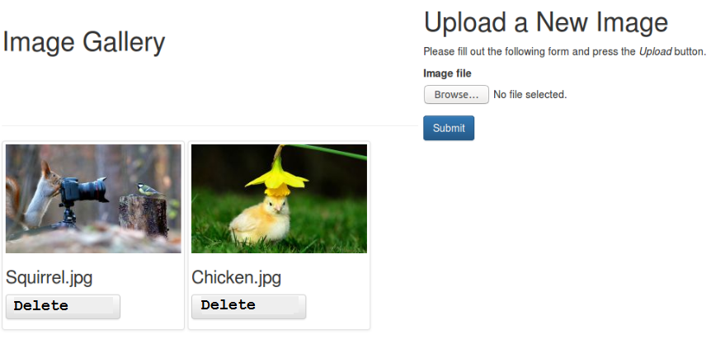
Task

Slide 15
const { randomUUID } = require('crypto'); // Added in: node v14.17.0
console.log(randomUUID()); // '89rct5ac2-8493-49b0-95d8-de843d90e6ca‘
const testFolder = './tests/';
const fs = require('fs');
fs.readdir(testFolder, (err, files) => {
files.forEach(file => {
console.log(file);
});
});
fs=require('fs') fs.readdir("./img/", (err,filename)=>console.log(filename))
=====
npm install fs-extra
// Requiring module
import fs from "fs-extra";
// Source file
const src = "file.txt";
// Destination path
const dest = "destination/file.txt";
// Function call
// Using promises
// Setting overwrite to true
fs.move(src, dest, { overwrite: true })
.then(() => console.log("File moved to the destination"+
" folder successfully"))
.catch((e) => console.log(e));

